Slide 1
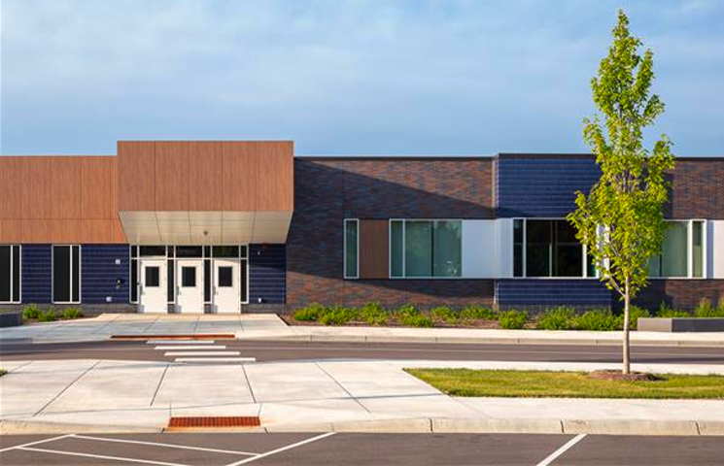
River East Therapeutic Day School Title 1 Annual Meeting Presentation 2023-2024

Slide 2
Vision- River East teaches scholars to adapt and develop skills required to be successful through academics, school-based therapy and positive relationships.

Slide 3
Title 1 is…………
United States Federal Government’s largest education program to support public schools.
- The purpose is to help every child receive a high quality education and to achieve the high academic standards set by the State of Minnesota.

Slide 4
4 Strategic Areas of Importance
1. Parents Right to Know
2. School Continuous Improvement Plan (SCIP)
3. Family Engagement Plan
4. Parent/Guardian Compact
2. School Continuous Improvement
3. Family Engagement Plan
4. Parent/Guardian Compact

Slide 5
Title One in Schools
Each school decides how Title 1 funds will be used in their school to improve education for all children.
- Data is reviewed to determine the greatest need for improvement in the school.
- The school staff, with input of parents, develops a school improvement plan with specific strategies to improve student achievement across the school.
- Teachers, administrators and parents work together to prioritize how Title 1 funds will be use to support the schools strategies to improve education for all students.

Slide 6
Parents have the right….
You can request information about your child’s progress by:
- Receiving FAST Reading and Math Scores
Having conferences with your child’s teacher
Progress Reports

Slide 7
School Continuous Improvement Plan
At River East the school Continuous Improvement strategies are:
- Improving Fast math and reading scores
- Completing the climate survey
- Working with teachers, parents and multiple contacts (administration, social workers, case managers, behavior specialists, etc.)

Slide 8
Curriculum Tools Used at Our School
Reading:
We use Guided Reading along with phonics instruction
- Assessments, instruction, and interventions are used to help with reading instruction along with
Coaching of teachers (formal, informal, and team) aligned to site-level SCIP literacy and equity goals
PD aligned to site-level SCIP literacy and equity goals
PLC meetings
Assessment and data analysis
Collaboration around curriculum, instructional frameworks, and intervention support
Modeling of teaching practices

Slide 9
Curriculum Tools Used at Our School
Writing:
The students write daily in their classes. They write own experiences, to show comprehension of stories read, and to fulfill the state standards for writing genres, which include: Personal Narrative, Persuasive/Opinion writing, Procedural writing, Informational writing, a Book Recommendation and a variety of poetry styles.

Slide 10
Curriculum Tools Used at Our School
Math
-Savvas math curriculum is used- it is the new math curriculum that was adopted by the school district.
Science/Social Studies/Health
- Curriculum is provided by the school district and is used in each classroom

Slide 11
Family Engagement Plan Working together in Partnership
The Family Engagement Plan is developed, revised and evaluated with families each year.
The plan describes how schools will:
- reach out to parents
-work with and support parents in their child’s education

Slide 12
Title 1 Supports families
Parents can help decide how our school uses our parent engagement funds
Examples include:
- Providing translators and interpreters during school meetings
- Hosting activities to assist parents in helping their child learn

Slide 13
Working together in Partnership
Schools and parents must also work together in developing a compact. The compact describes how the school and parents will work together to support student’s learning.
Parents-Guardian can be involved by meeting with administrator and/or participate in leadership meetings.
Parents can get involved by:
- Having conferences
- Meetings

Slide 14
For more information about Title 1
If you have questions about Title 1 you can contact:
Title 1 Office- 651-632-3790
School Principal- Katherine Horton- 651-744-2657

